Slide 1


GBME Probability and Statistics | Fall 2018
Lecture 03 | 091018
Lecture 03
Data visualization
CHOONG-WAN WOO | COCOAN lab | http://cocoanlab.github.io

Slide 2
Lecture 03 | 091018
Key Points
Class materials: https://github.com/wanirepo/Stats_2018Fall
Discussion: https://piazza.com/sungkyunkwan_university/fall2018/gbe3037/home
Chapter 1 & 2
What is statistics?
Data in context, data table (cases and variables)
Chapter 3: Displaying and describing categorical data
Chapter 4: Displaying and summarizing quantitative data
CHOONG-WAN WOO | COCOAN lab | http://cocoanlab.github.io

Slide 3

Lecture 03 | 091018
Three Rules of Data Analysis
Make a picture
Make a picture
Make a picture
To think, show, and tell…
And to make it cool!
E.g., https://d3js.org
CHOONG-WAN WOO | COCOAN lab | http://cocoanlab.github.io

Slide 4
Lecture 03 | 091018
Why visualization matters
We’re lazy and don’t like to read
Some information isn’t easy to describe verbally
Statistical summaries can be misleading
Aesthetically-pleasing visuals are engaging
Anscombe's quartet:
https://en.wikipedia.org/wiki/Anscombe%27s_quartet
Slide credit: Tal Yarkoni
CHOONG-WAN WOO | COCOAN lab | http://cocoanlab.github.io

Slide 5
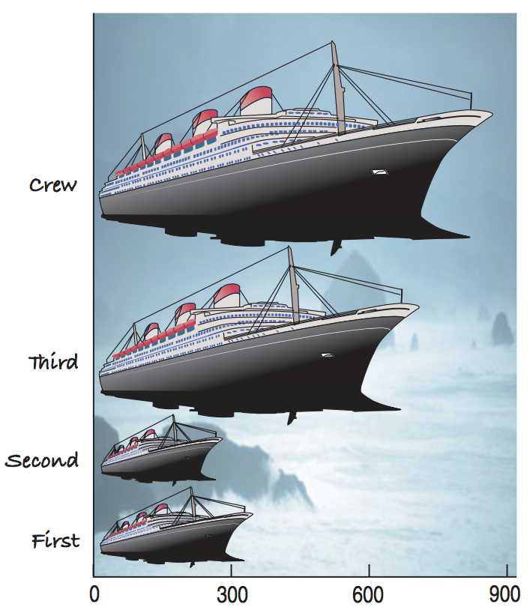
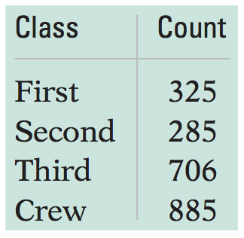
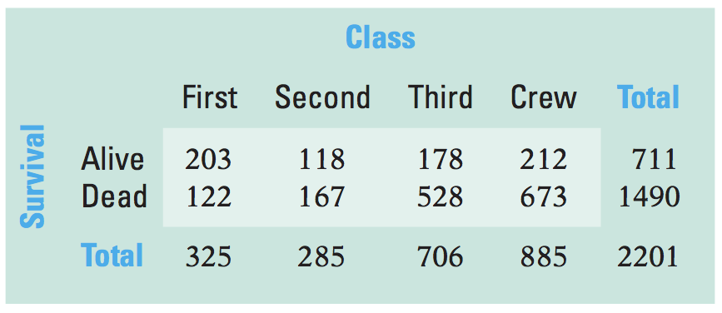
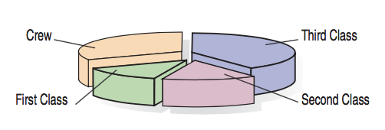
Lecture 03 | 091018
Textbook’s example data
Frequency/contingency table of “ticket class” and “Survival” for the Titanic passengers
Frequency table
Contingency table
What’s wrong with this plot?
“Area principle”: the area occupied by a part of the graph should correspond to the magnitude of the value it represents.
CHOONG-WAN WOO | COCOAN lab | http://cocoanlab.github.io

Slide 6
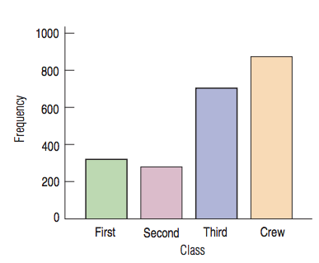
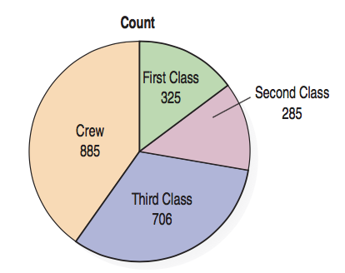
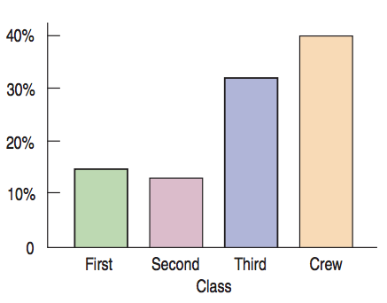
Lecture 03 | 091018
Bar Charts, Pie Charts
Relative frequency bar chart
CHOONG-WAN WOO | COCOAN lab | http://cocoanlab.github.io

Slide 7
Lecture 03 | 091018
Marginal distribution, conditional distribution
Marginal distribution of “Survival”
Contingency table
Conditional distribution
(satisfy a condition on another variable)
Marginal distribution of “Class”
CHOONG-WAN WOO | COCOAN lab | http://cocoanlab.github.io

Slide 8
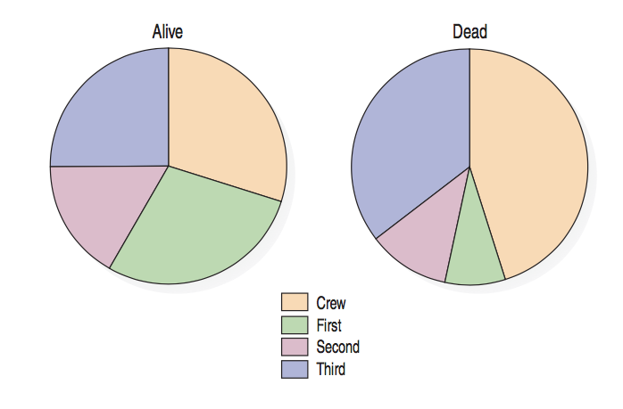
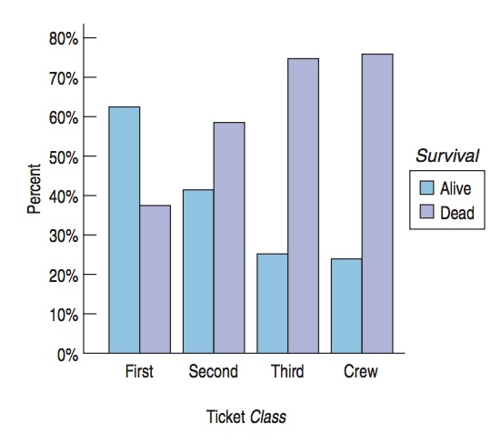
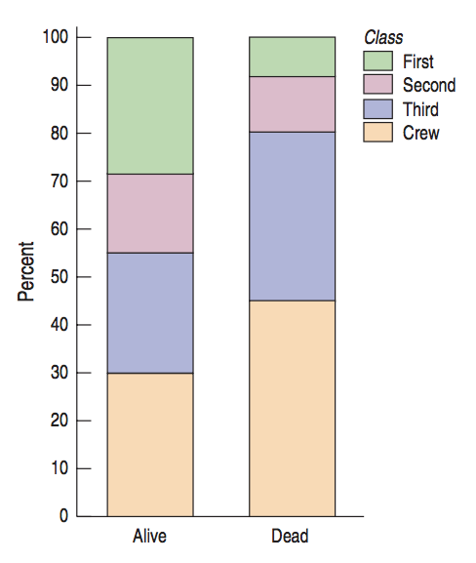
Lecture 03 | 091018
Charts for conditional distribution
The variables are independent: “when the distribution of one variable tells us nothing about the distribution of the other variable”
CHOONG-WAN WOO | COCOAN lab | http://cocoanlab.github.io

Slide 9
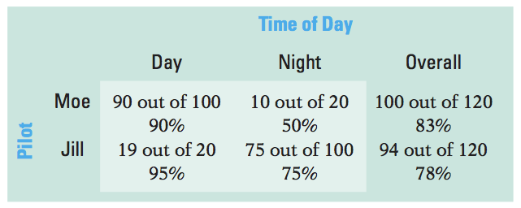
Lecture 03 | 091018
Simpson’s Paradox
Two pilots, Moe and Jill
Who is the better pilot?
Proportion of on-time flights
CHOONG-WAN WOO | COCOAN lab | http://cocoanlab.github.io

Slide 10
Lecture 03 | 091018
Simpson’s Paradox
Two pilots, Moe and Jill
Who is the better pilot?
Now who is the better pilot?
Don’t average over things unfairly
Different numbers in different categories for Day and Night
Unfair to average across categories
Proportion of on-time flights
CHOONG-WAN WOO | COCOAN lab | http://cocoanlab.github.io

Slide 11
Lecture 03 | 091018
Key Points
Chapter 3: Displaying categorical data
Bar chart for categorical data
Pie chart for proportions of whole
Faithful reporting and the area principle
Contingency tables
Simpson’s paradox
CHOONG-WAN WOO | COCOAN lab | http://cocoanlab.github.io

Slide 12
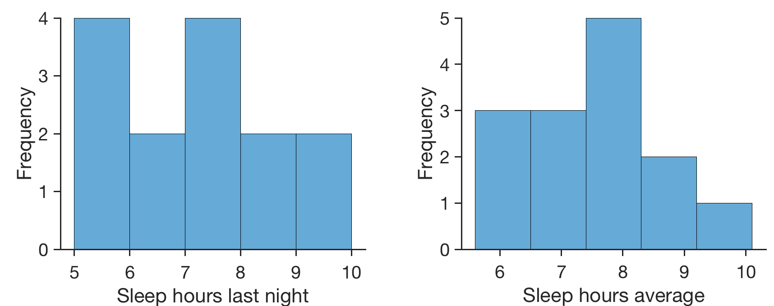
Lecture 03 | 091018
Histograms for quantitative data
 | sleep_hours_last_night | sleep_hours_average
Indiv 1 | 7 | 6
Indiv 2 | 5.5 | 6.5
Indiv 3 | 9 | 7
Indiv 4 | 5 | 7
Indiv 5 | 5 | 6
Indiv 6 | 7 | 8
Indiv 7 | 8 | 7
Indiv 8 | 7 | 8
Indiv 9 | 8 | 10
Indiv 10 | 10 | 9
Indiv 11 | 6 | 7.5
Indiv 12 | 7 | 9
Indiv 13 | 6 | 8
Indiv 14 | 5 | 8
CHOONG-WAN WOO | COCOAN lab | http://cocoanlab.github.io

Slide 13
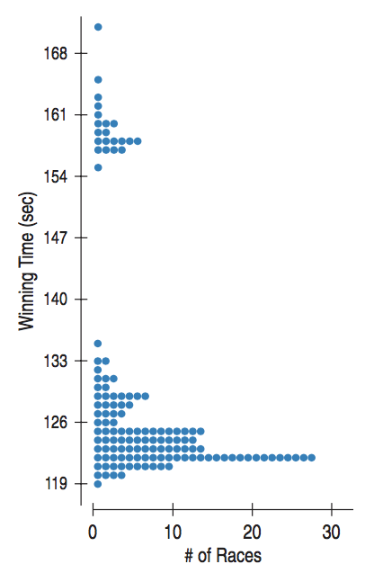
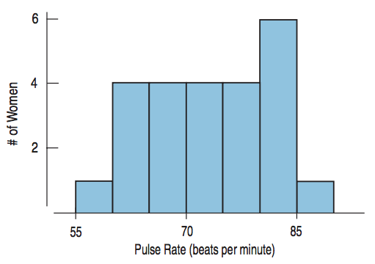
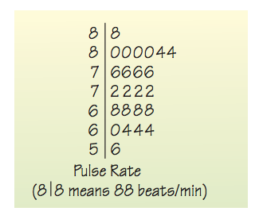
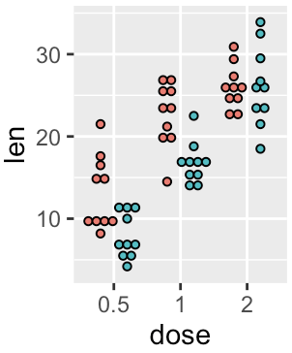
Lecture 03 | 091018
Stem/leaf, dot plot
Histogram
Stem-and-leaf display
Dotplots
CHOONG-WAN WOO | COCOAN lab | http://cocoanlab.github.io

Slide 14
Lecture 03 | 091018
Shape
Modes?
http://researchhubs.com/post/ai/data-analysis-and-statistical-inference/visualizing-numerical-data.html
CHOONG-WAN WOO | COCOAN lab | http://cocoanlab.github.io

Slide 15
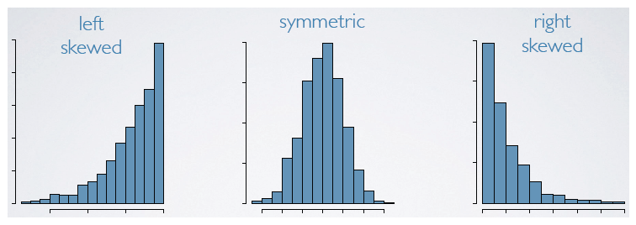
Lecture 03 | 091018
Shape
Modes?
Symmetric?
http://researchhubs.com/post/ai/data-analysis-and-statistical-inference/visualizing-numerical-data.html
CHOONG-WAN WOO | COCOAN lab | http://cocoanlab.github.io

Slide 16
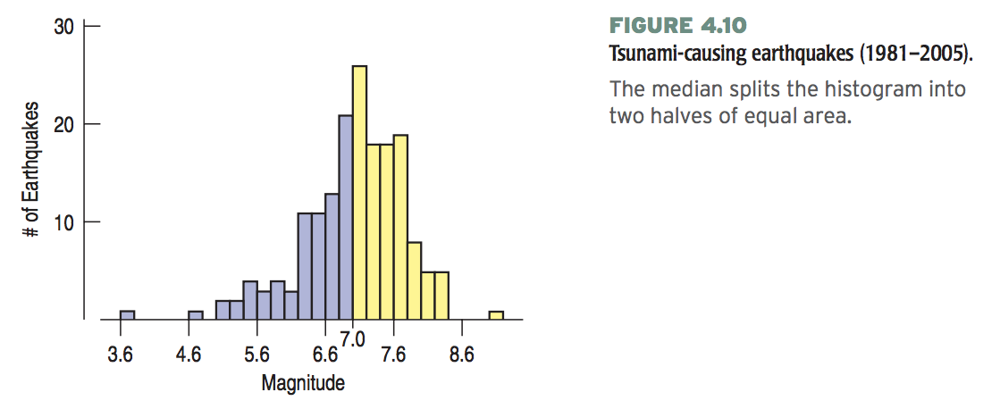
Lecture 03 | 091018
Center
Median
176 earthquakes
Median: (176+1)/2 = 88.5th value in the sorted data
“.5” = average of the two values (88th and 89th)
If there was 221 earthquakes
Median: (221+1)/2 = 111th value in the sorted data
CHOONG-WAN WOO | COCOAN lab | http://cocoanlab.github.io

Slide 17
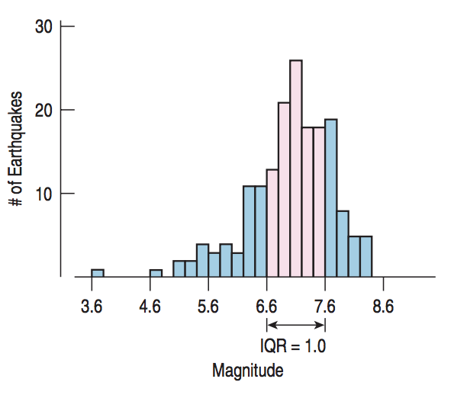
Lecture 03 | 091018
Spread
Range
Range = max – min
Interquartile range
Interquartile range (IQR) = upper quartile – lower quartile
50%
CHOONG-WAN WOO | COCOAN lab | http://cocoanlab.github.io

Slide 18
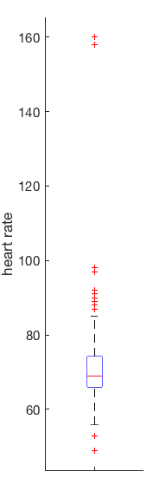
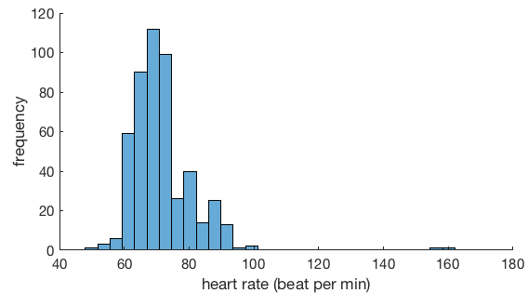
Lecture 03 | 091018
Boxplots and 5-Number Summaries
far outliers
My heart rate data for a week (7/10-7/14)
Max | 160
Q3 | 74
Median | 69
Q1 | 66
Min | 49
outliers
Q3 + 1.5 IQR
Q3
Median
Q1
Q1 - 1.5 IQR
CHOONG-WAN WOO | COCOAN lab | http://cocoanlab.github.io

Slide 19
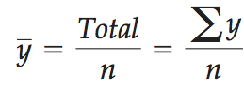
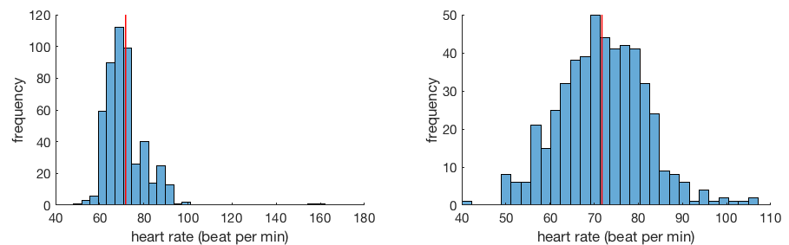
Lecture 03 | 091018
Center of Symmetric Distribution: Mean
If the histogram is symmetric and there are no outliers, the mean will be preferable.
However, if the histogram is skewed or has outliers, the median might be better.
CHOONG-WAN WOO | COCOAN lab | http://cocoanlab.github.io

Slide 20
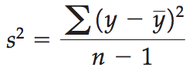
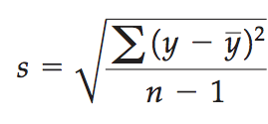
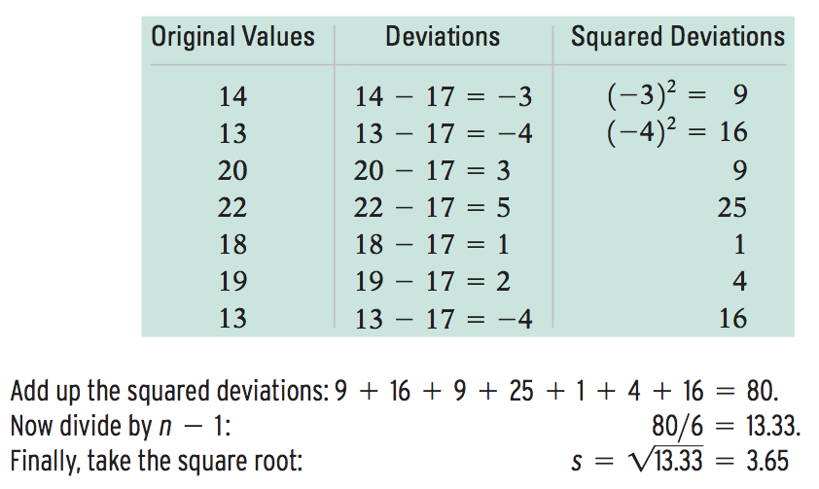
Lecture 03 | 091018
Spread of Symmetric Distribution: Standard Deviation
Variance
Standard Deviation
Mean = 17
CHOONG-WAN WOO | COCOAN lab | http://cocoanlab.github.io

Slide 21
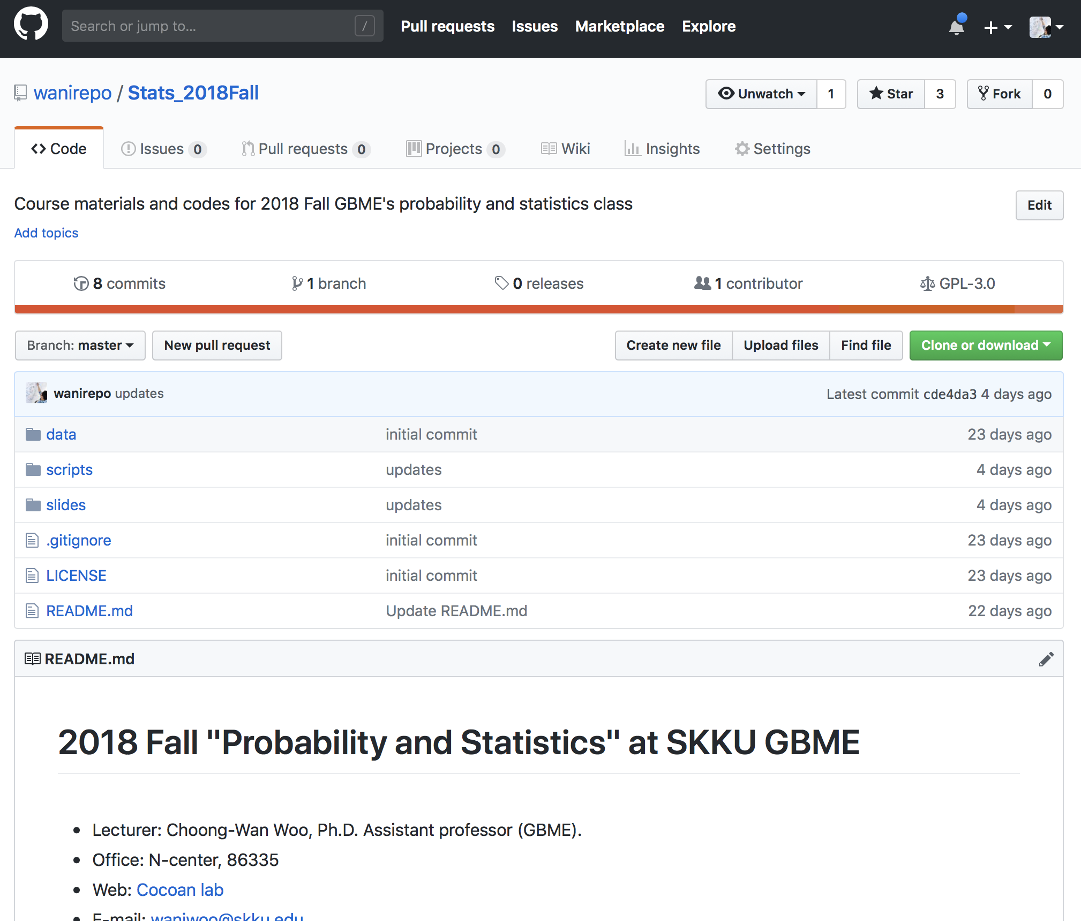
Lecture 03 | 091018
Let’s review the code:
Source code: /scripts/L03_heartrate.m
Code & output: /scripts/L03_heartrate.html
To see html, you have to download the files!
CHOONG-WAN WOO | COCOAN lab | http://cocoanlab.github.io

Slide 22
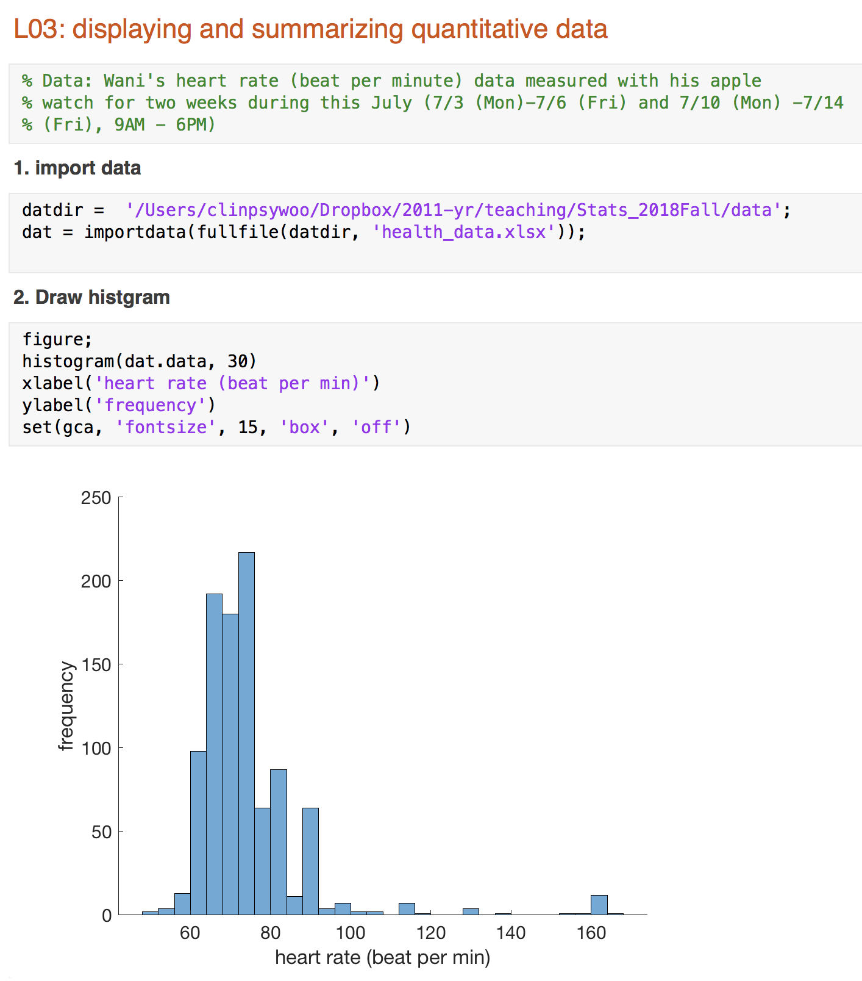
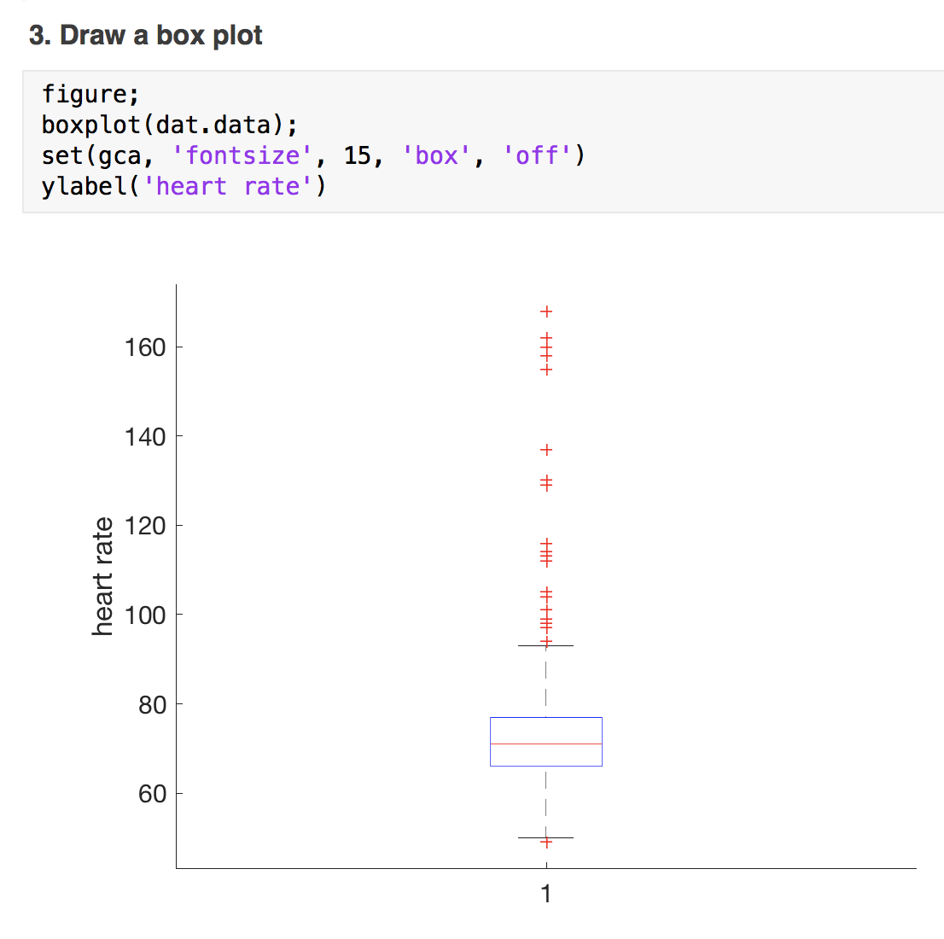
Lecture 03 | 091018
To run this, you have to change the path

Slide 23
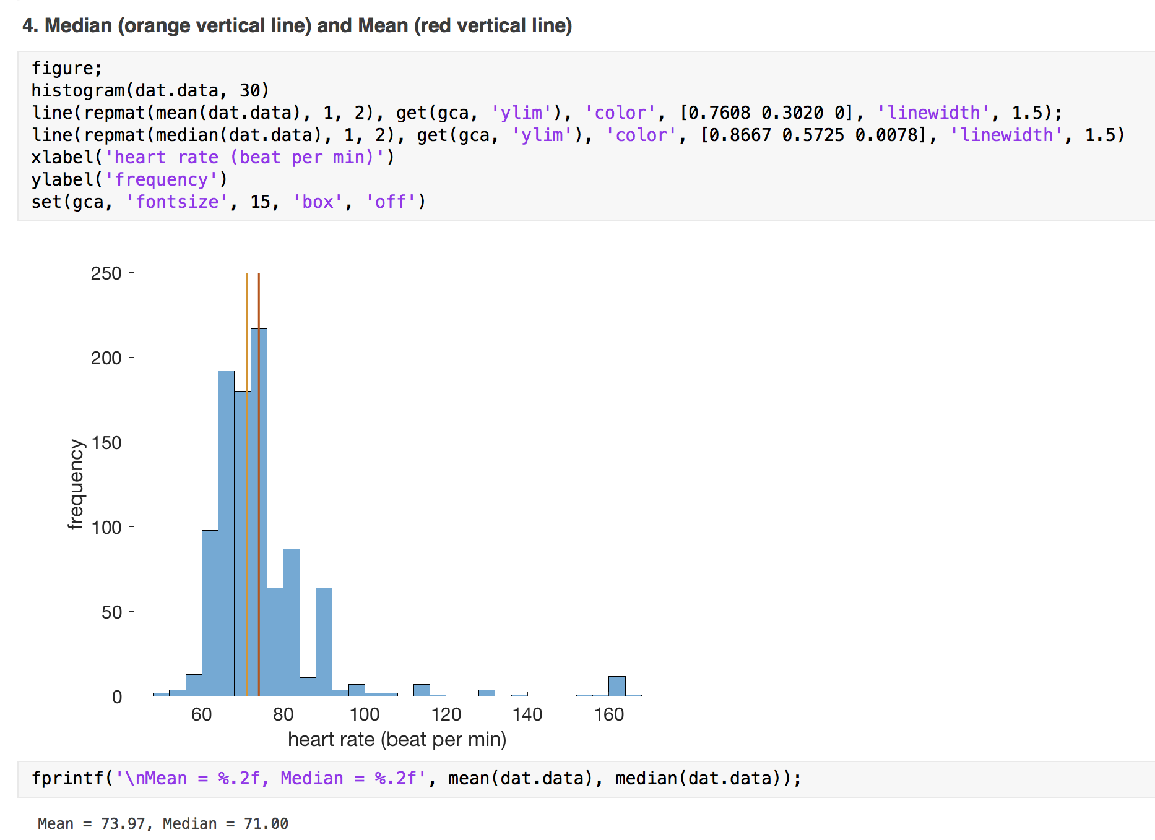
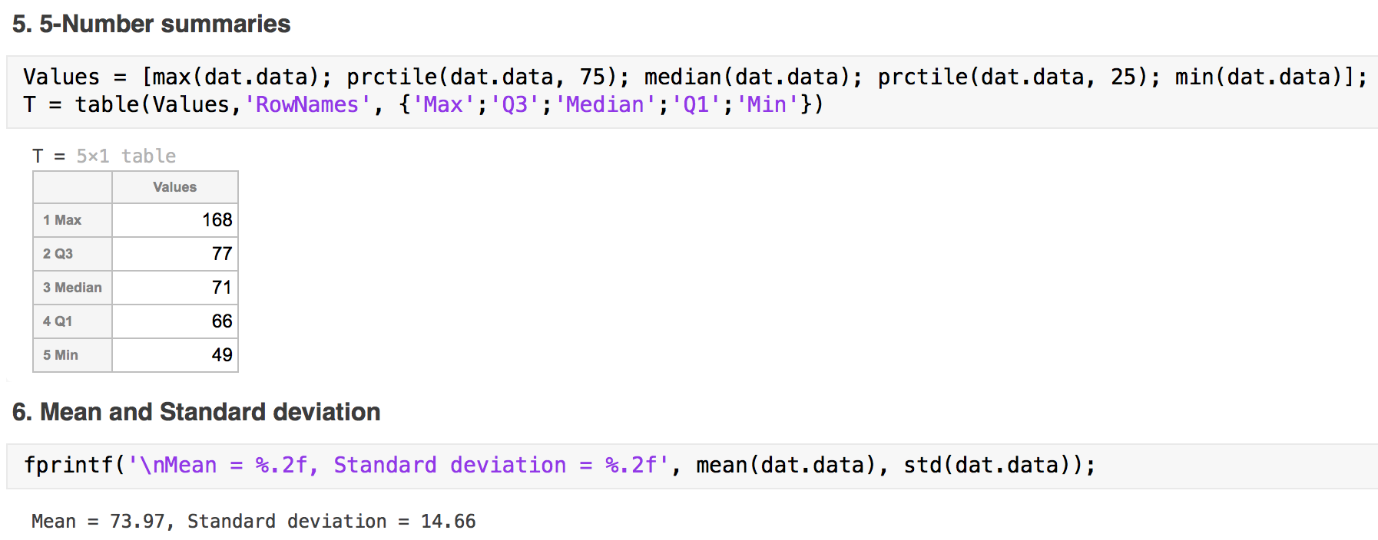
Lecture 03 | 091018

Slide 24
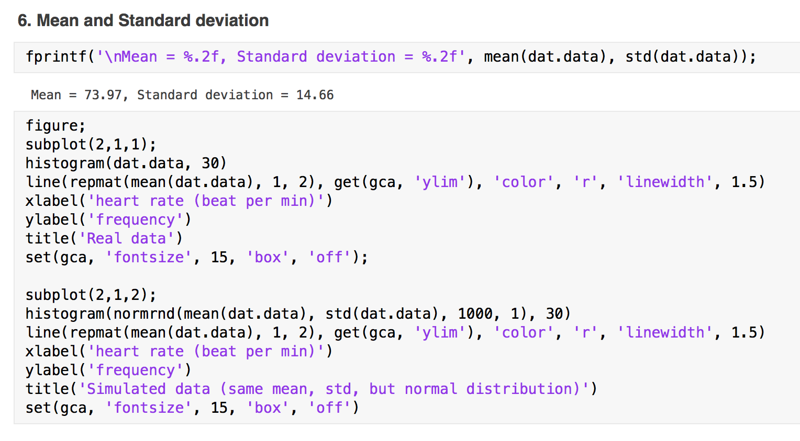
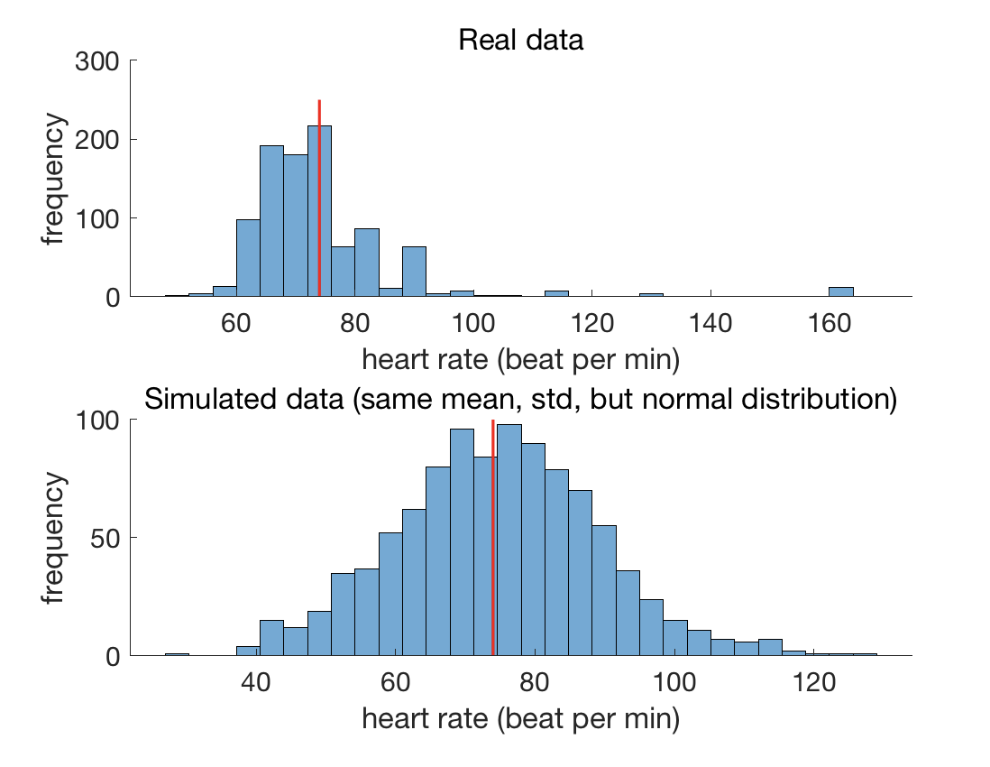
Lecture 03 | 091018

Slide 25
Lecture 03 | 091018
Key Points
Chapter 3: Displaying categorical data
Bar chart for categorical data
Pie chart for proportions of whole
Faithful reporting and the area principle
Contingency tables
Simpson’s paradox
Chapter 4: Displaying quantitative data
Histograms, Stem-leaf, dot plots
Shape (mode, symmetrical)
Center (median, mean)
Spread (range, IQR, variance, standard deviation)
Box plots
CHOONG-WAN WOO | COCOAN lab | http://cocoanlab.github.io

